Slide 1


Slide 2




Software engineer at Datadog
Research engineer in various Universities
Creator of 6 viz-related websites

Slide 3
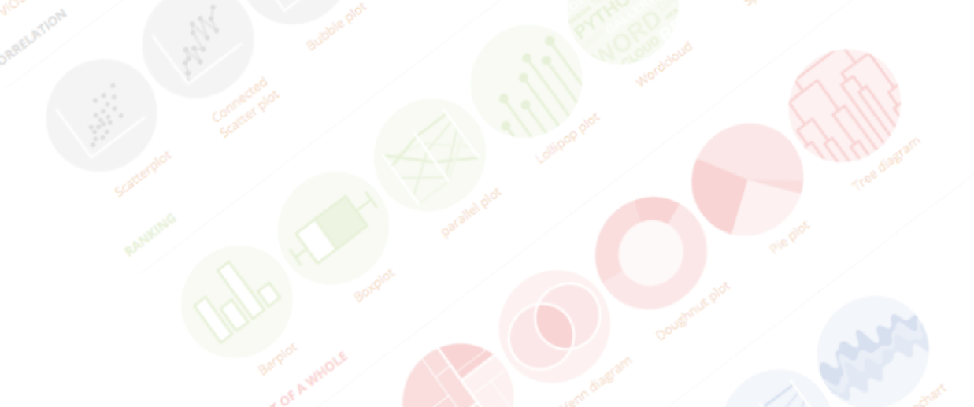

A project by Yan Holtz
Choosing the right chart for your data
Remote | May 2022

Slide 4

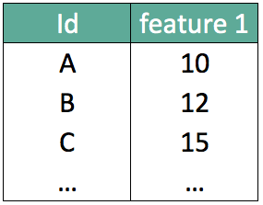
What should I do with my data ??

Slide 5
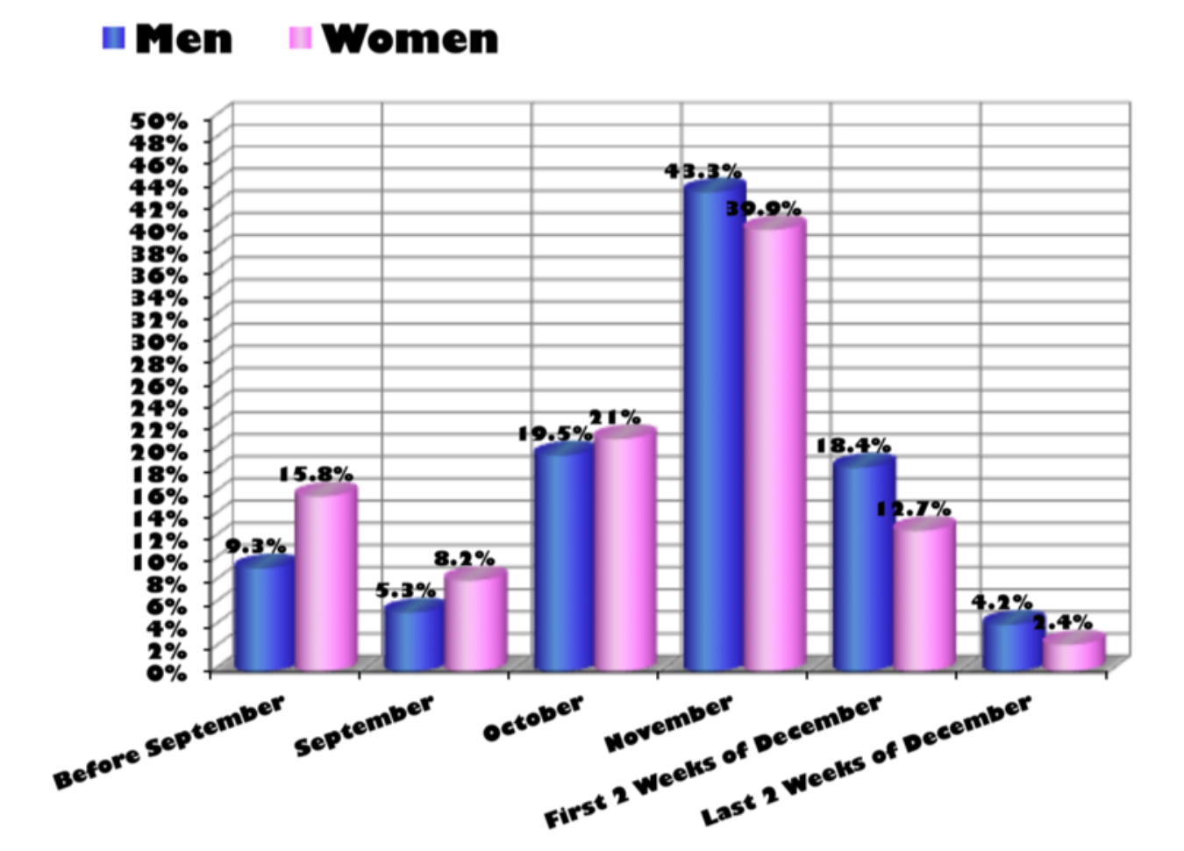
…
What about that?
Source: Storytelling with data by Cole Nussbaumer Knaflic

Slide 6

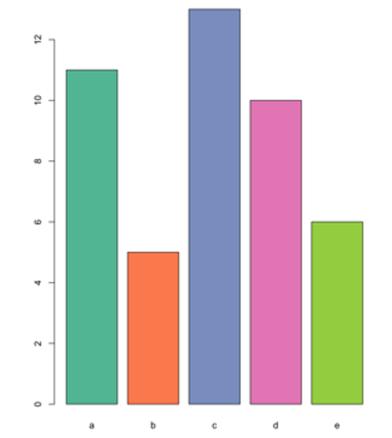

Design
Code

Slide 7
Design
Code

Slide 8
Looking for a chart ?
What you can do
What you should do
Caveats to avoid
How to
build it

Slide 9
WHAT YOU CAN DO
A classification of chart types based on data input format
www.data-to-viz.com/#explore

Slide 10

Scatterplot

Slide 11

Scatterplot
2d density chart

Slide 12
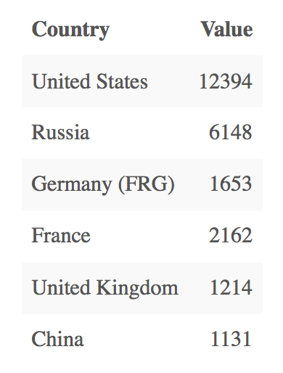
Who sells more weapons ?
?
Notes:
Very simple dataset,
-> What would you do ?
quantity of weapons exported by the top 50 largest exporters in 2017.
on the Stockholm International Peace Research Institute

Slide 13
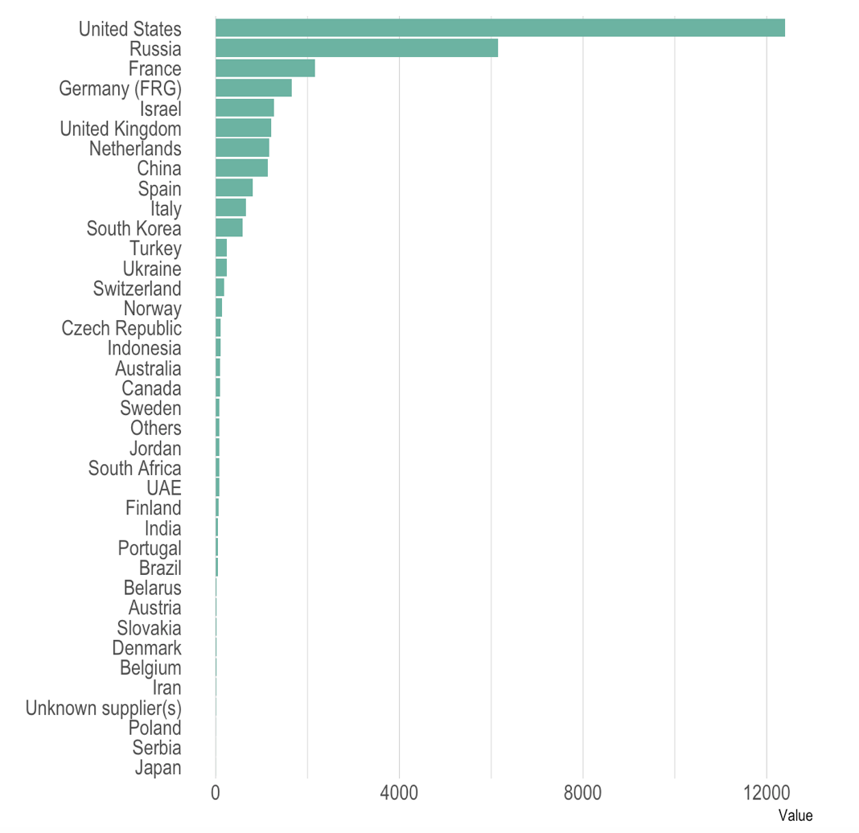
Who sells more weapons ?

Slide 14
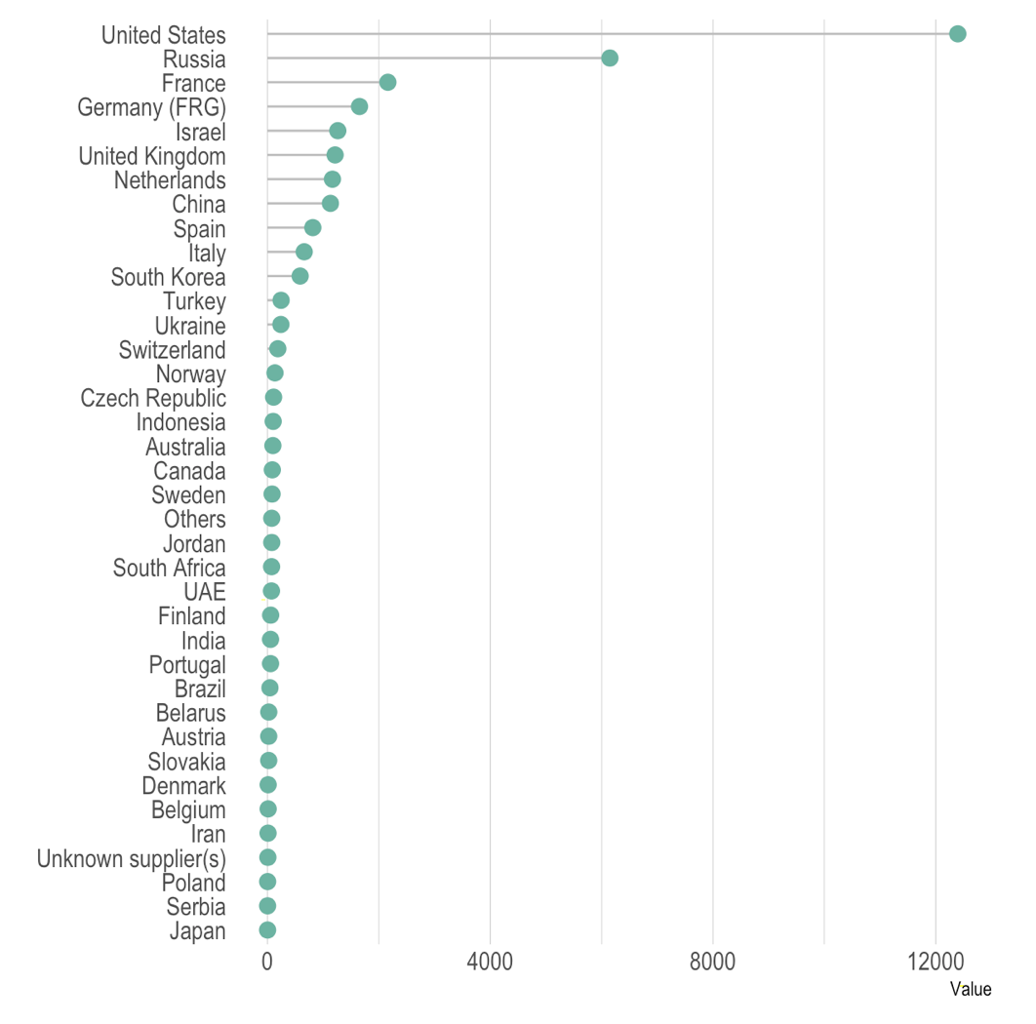
Who sells more weapons ?

Slide 15
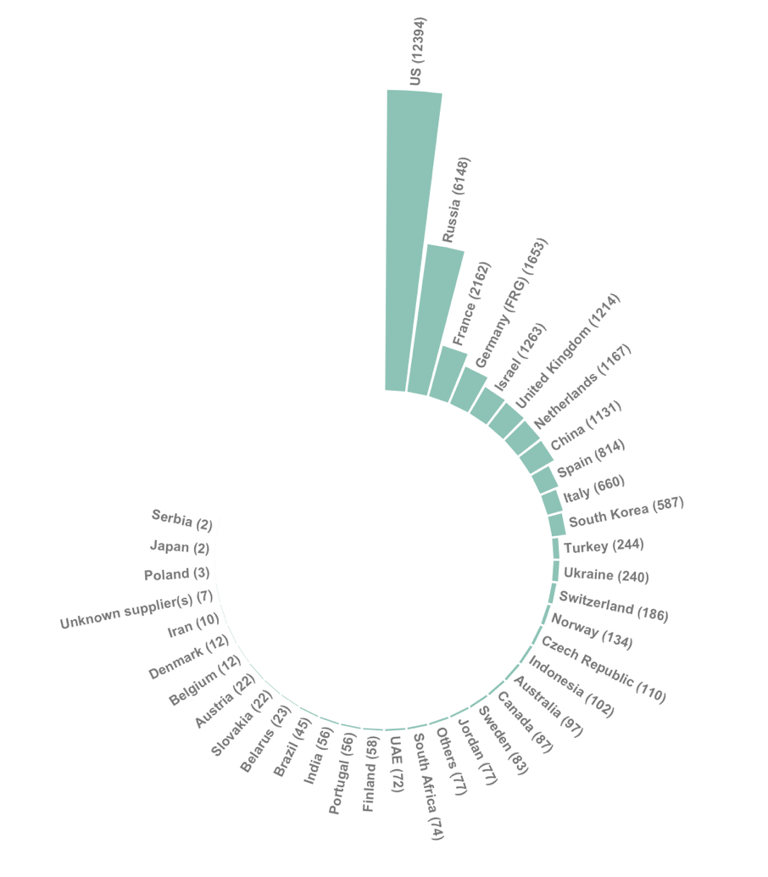
Who sells more weapons ?

Slide 16
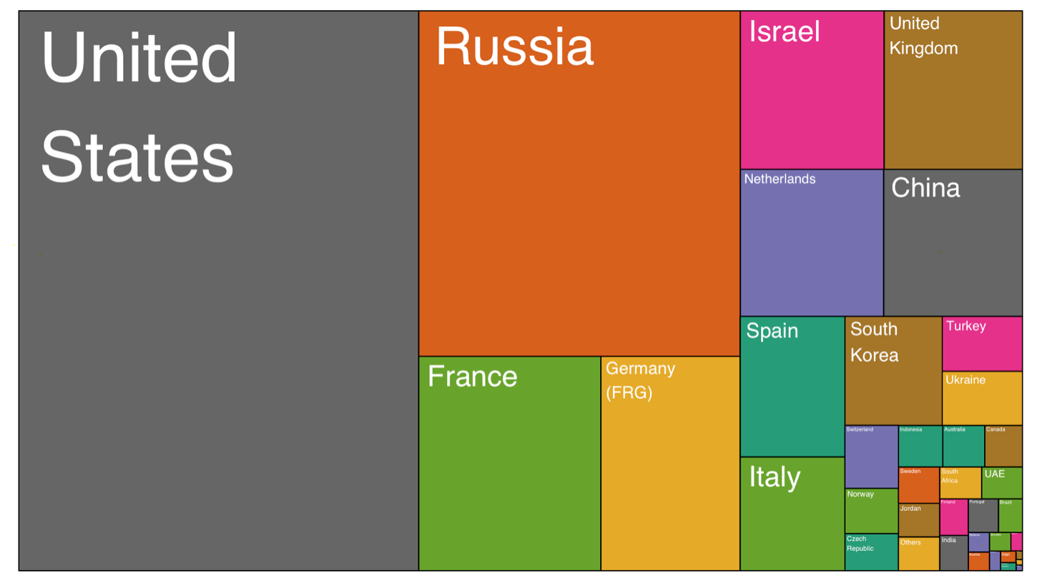
Who sells more weapons ?

Slide 17
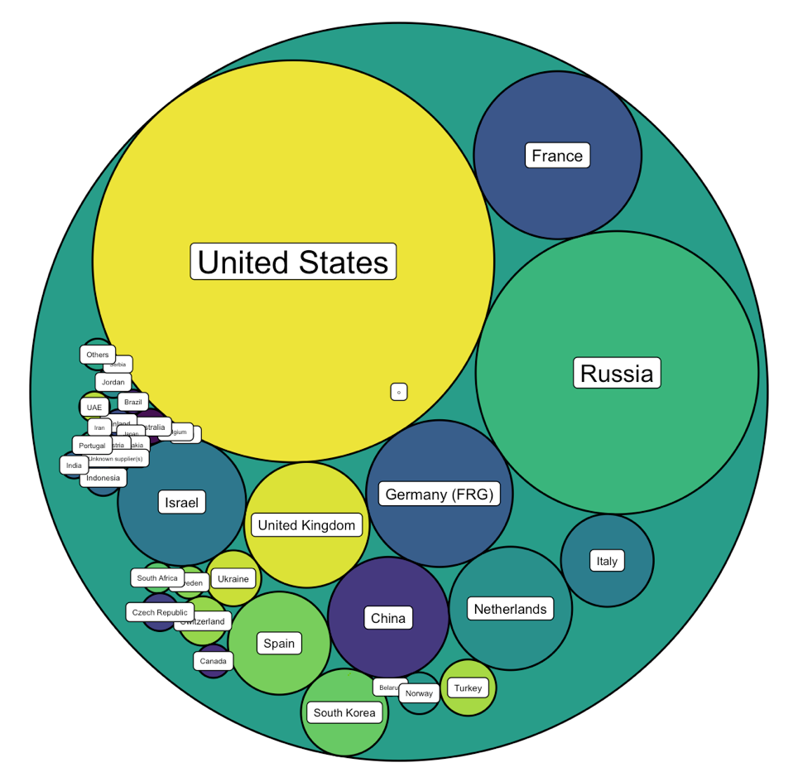
Who sells more weapons ?

Slide 18







Who sells more weapons ?

Slide 19
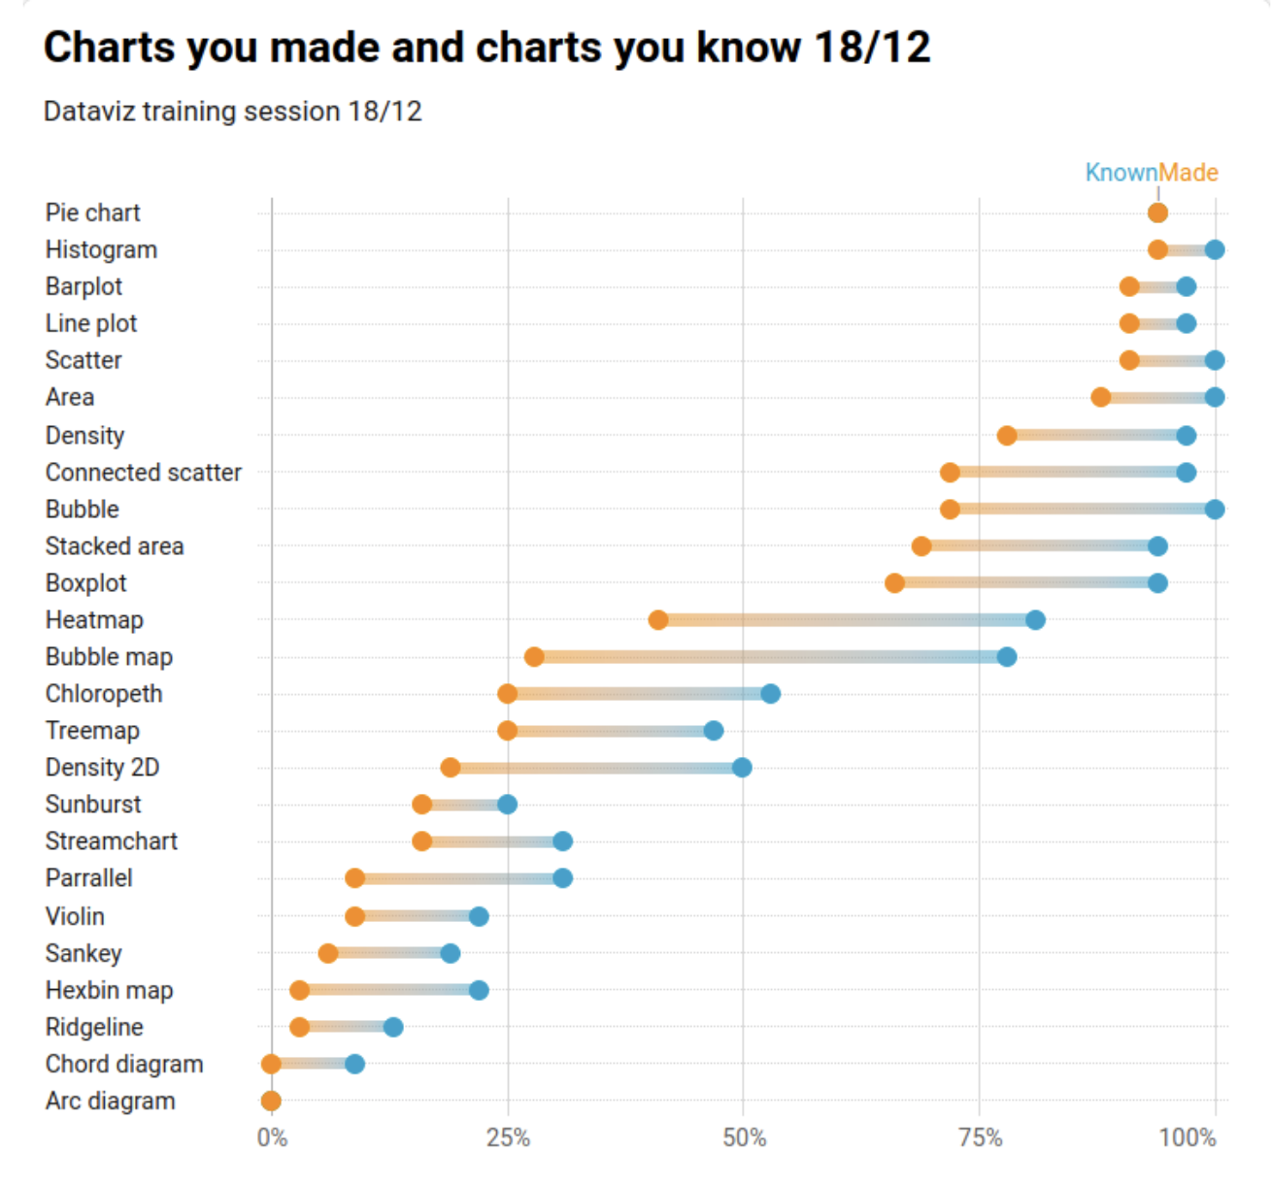

Slide 20
Who sells more weapons ?
1 observation per group
1 categorical variable
1 numerical variable

Slide 21
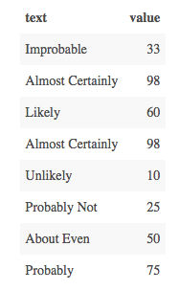
Perception of probability

Slide 22
Perception of probability
Several observations per group
1 categorical variable
1 numeric variable

Slide 23
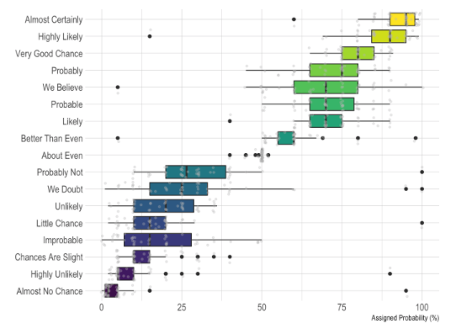
Perception of probability

Slide 24
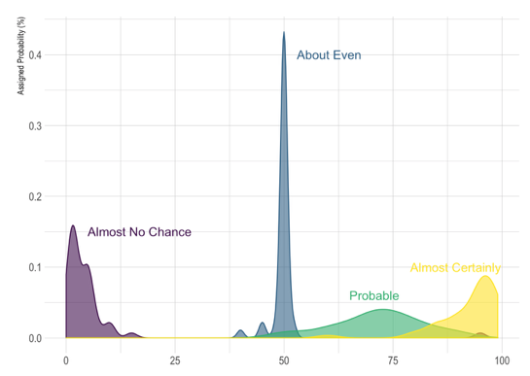
Perception of probability

Slide 25
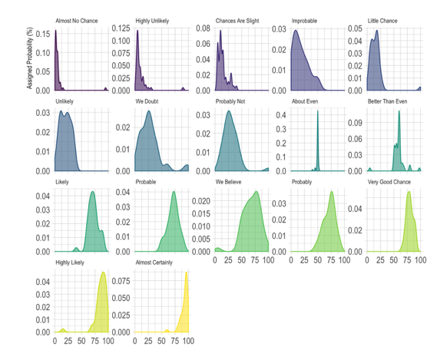
Perception of probability

Slide 26
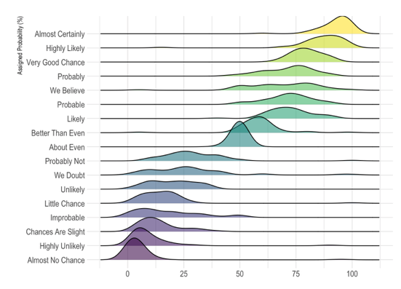
Perception of probability

Slide 27
So…
Knowing the possibilities is the first step in chart choice
Not easy to know all the chart types
Hard to figure out options from a dataset
Let’s build a decision tree
Notes:
Demo first part of the website

Slide 28
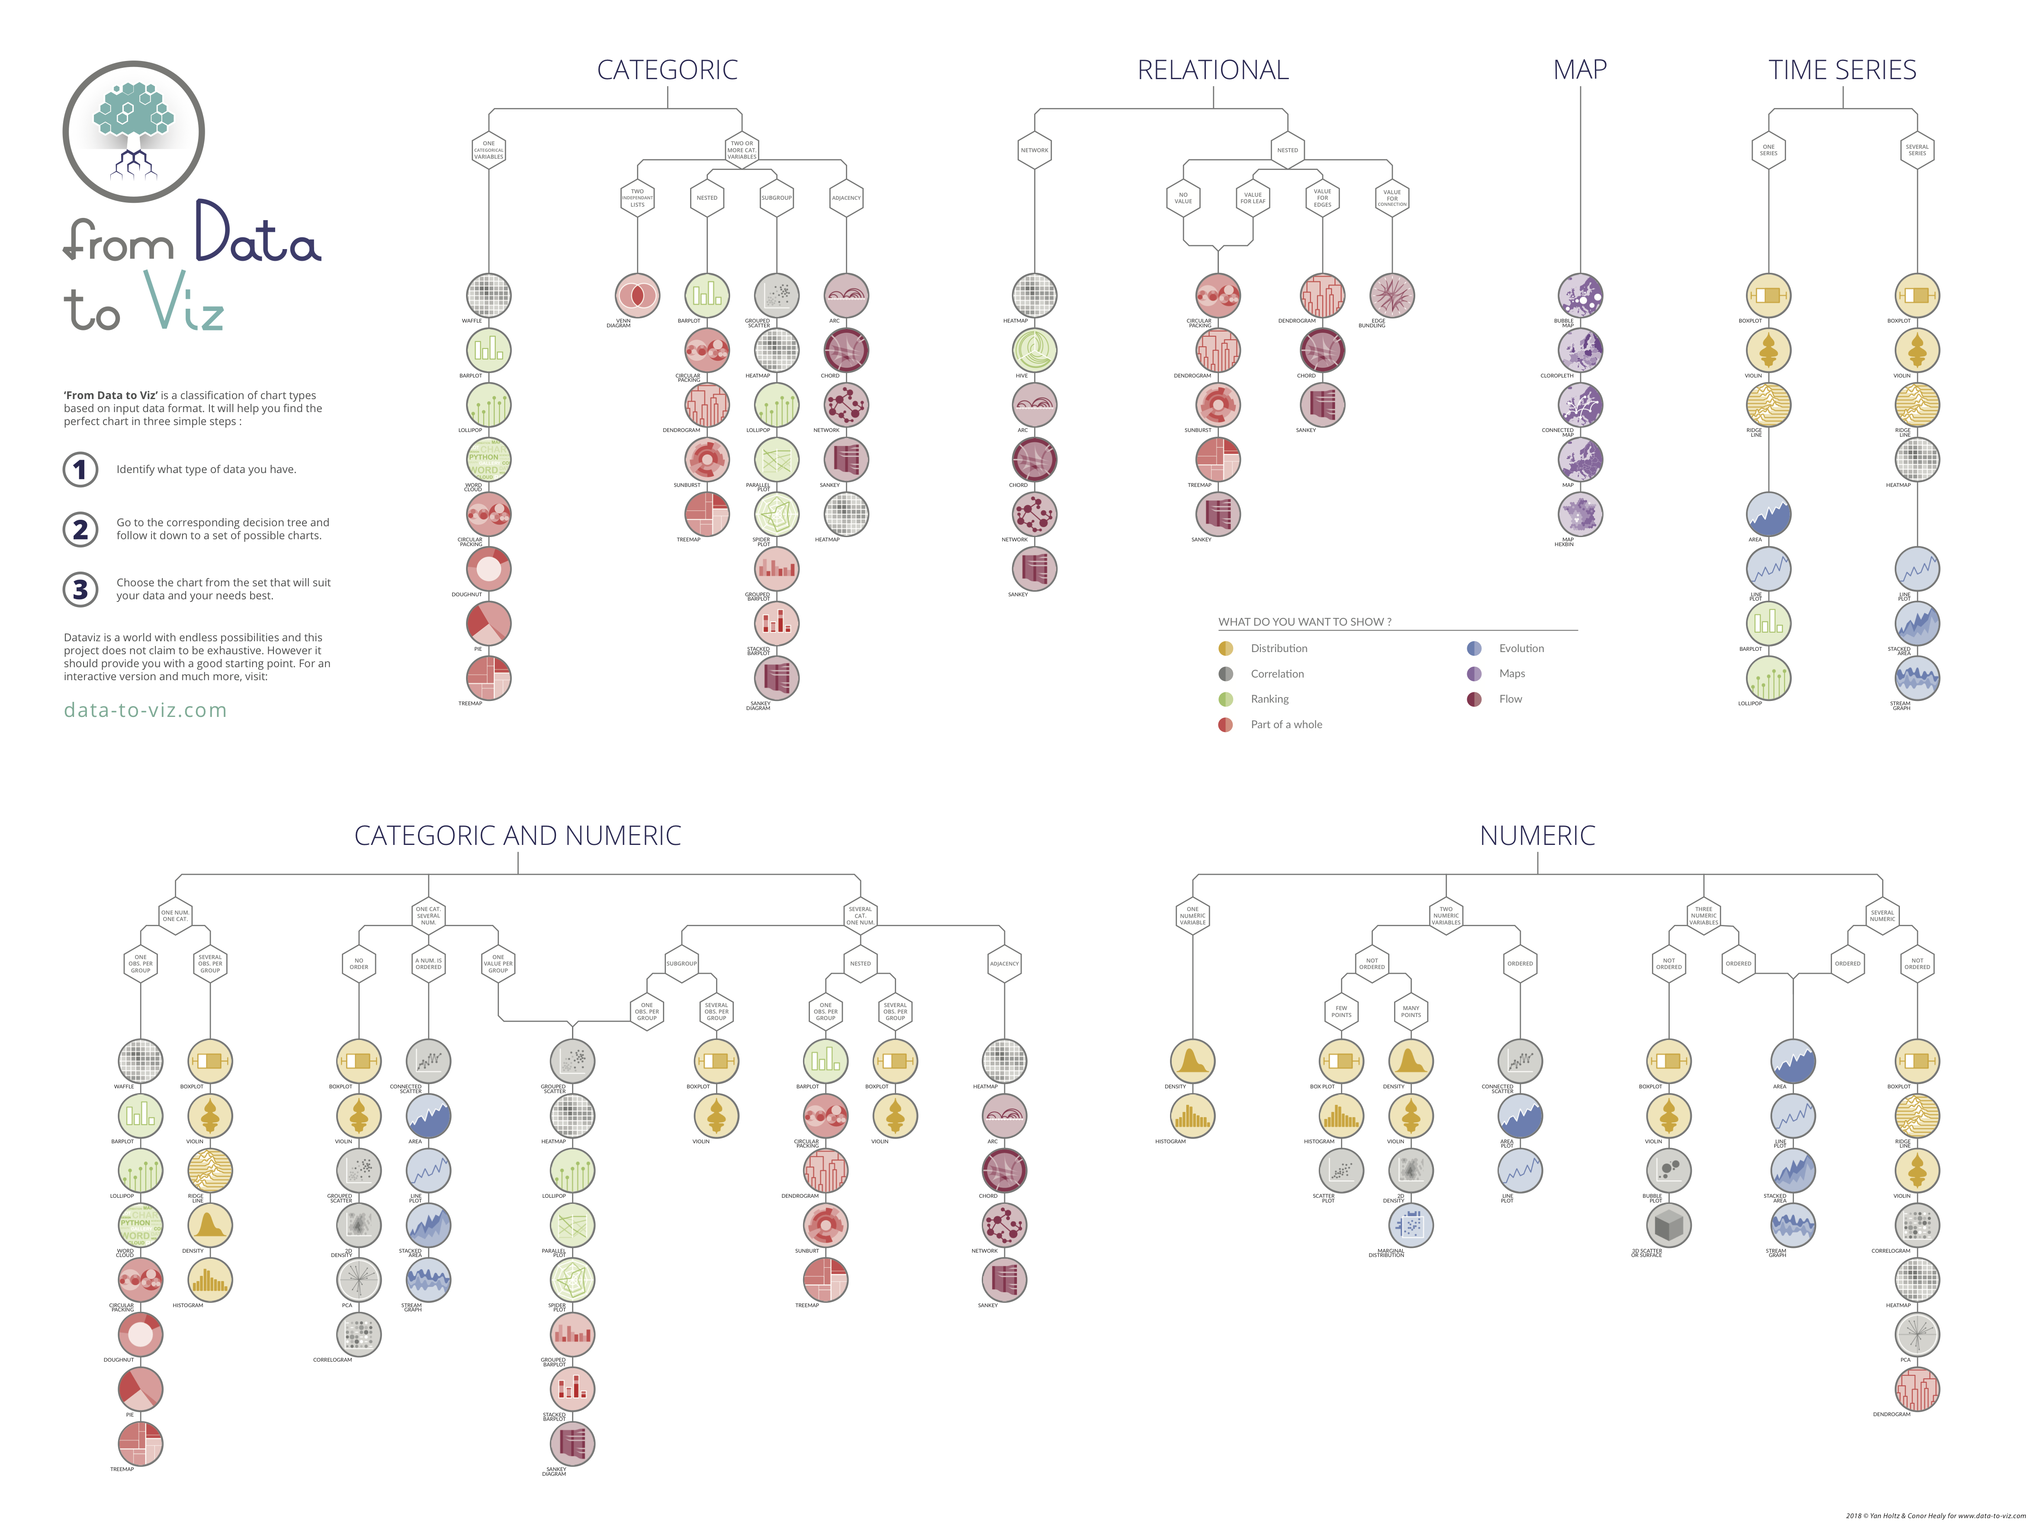
Notes:
+ WEBSITE DEMO

Slide 29
Data-to-viz.com
Notes:
Demo first part of the website

Slide 30
There are no limits in dataviz!
https://xeno.graphics/
Notes:
+ WEBSITE DEMO

Slide 31
WHAT YOU SHOULD DO
About 20 examples of storytelling with data
www.data-to-viz.com/#story

Slide 32
Eye catching / accurate
Question
Exploratory vs Explanatory
Chart Decision
Interactive or Static?
Who’s reading ?
Data itself

Slide 33
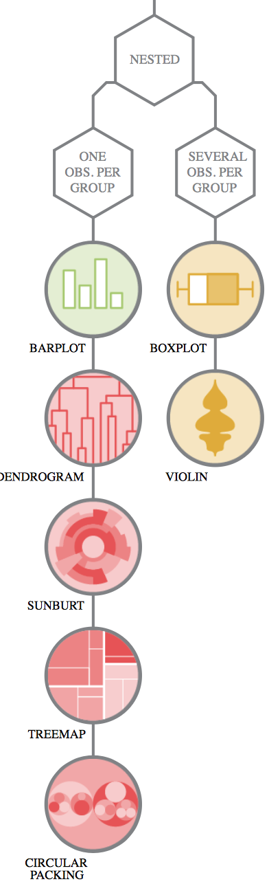
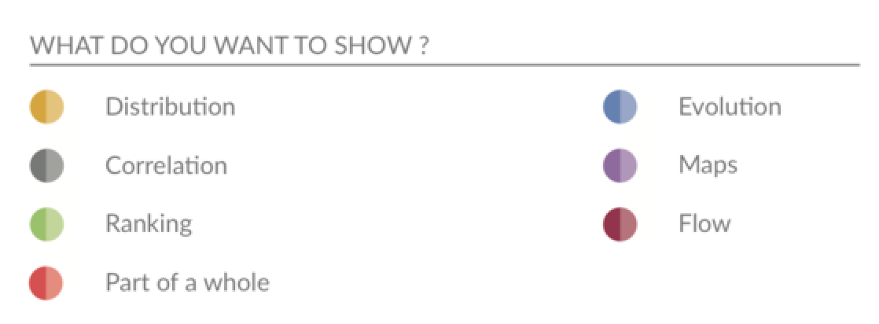
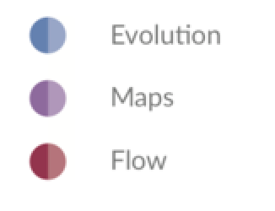
Question – Explo/Expla – Reader – Data – Interactivity – Eye catching
Notes:
Demo story part of the website Show that code is available

Slide 34
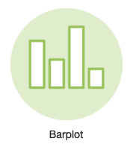
Who sells more weapons ?
South Korea > Spain ?
% of total sold by the US ?

Slide 35
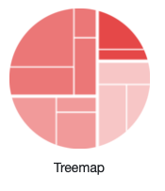
Who sells more weapons ?
South Korea > Spain ?
% of total sold by the US ?

Slide 36
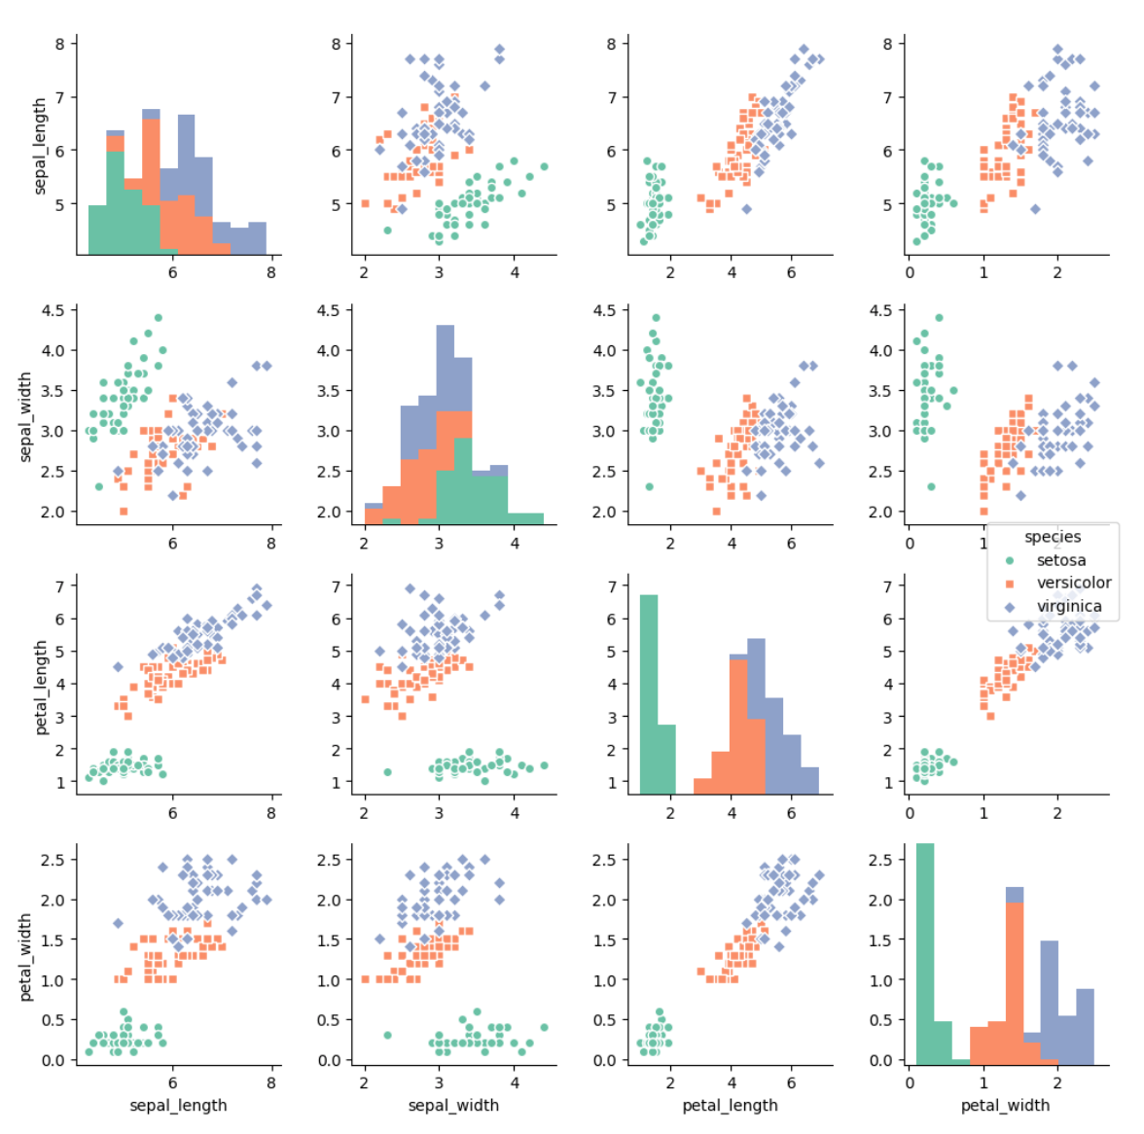
Question – Explo/Expla – Reader – Data – Interactivity – Eye catching
Notes:
Demo story part of the website Show that code is available

Slide 37
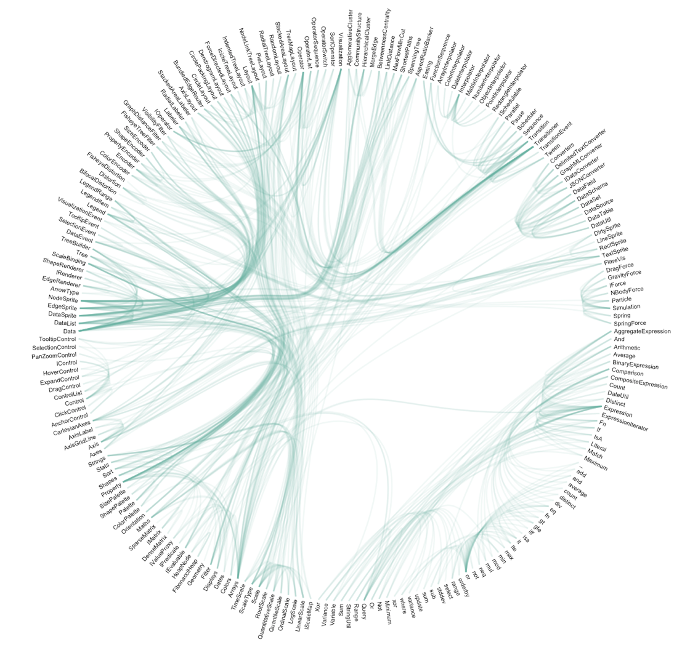
Question – Explo/Expla – Reader – Data – Interactivity – Eye catching
Notes:
Demo story part of the website Show that code is available

Slide 38
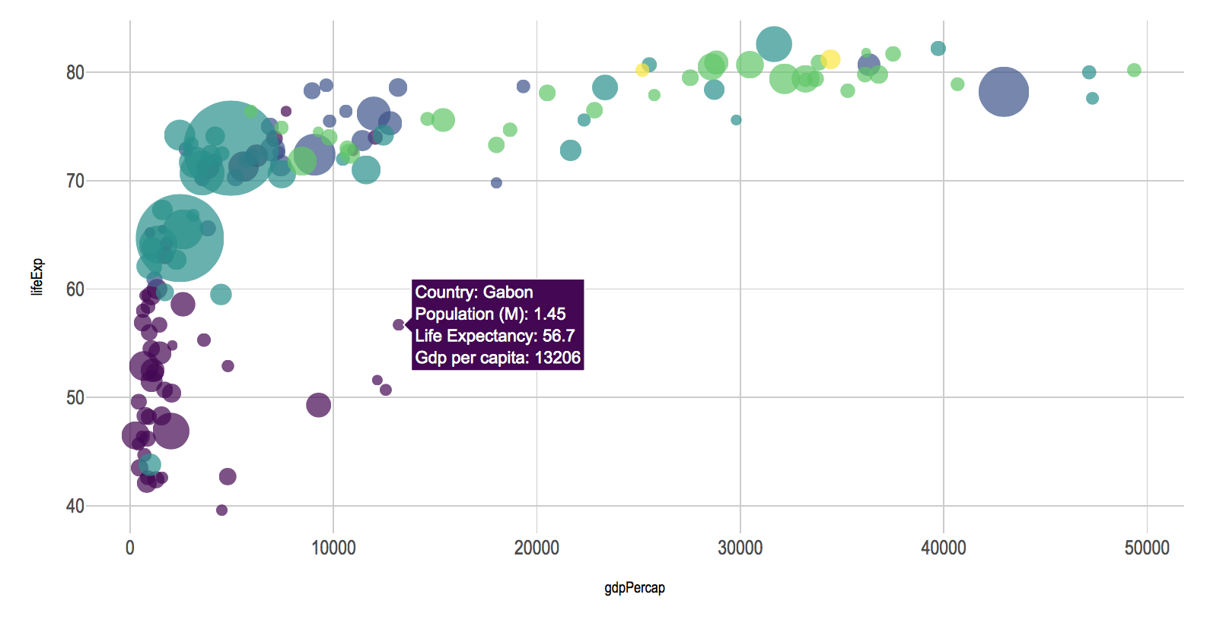
Question – Explo/Expla – Reader – Data – Interactivity – Eye catching
Notes:
Demo story part of the website Show that code is available

Slide 39
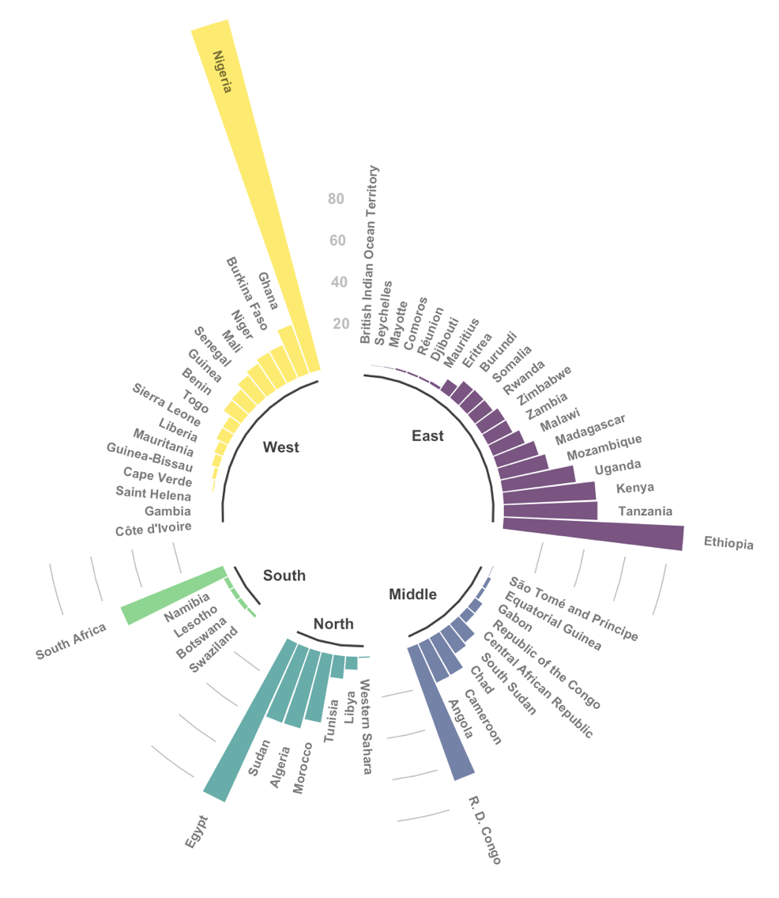
Question – Explo/Expla – Reader – Data – Interactivity – Eye catching
Notes:
Demo story part of the website Show that code is available

Slide 40
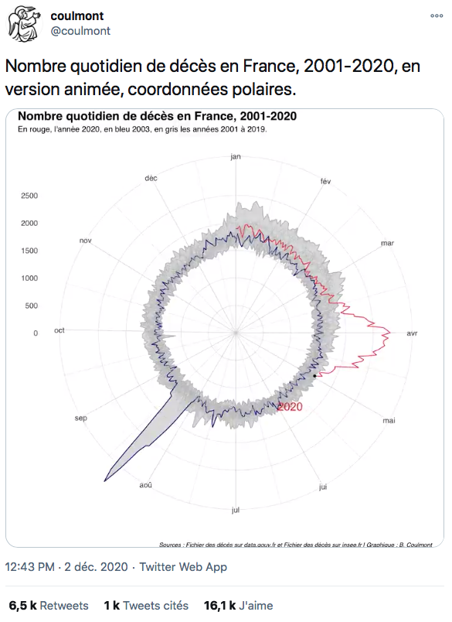
Link

Slide 41
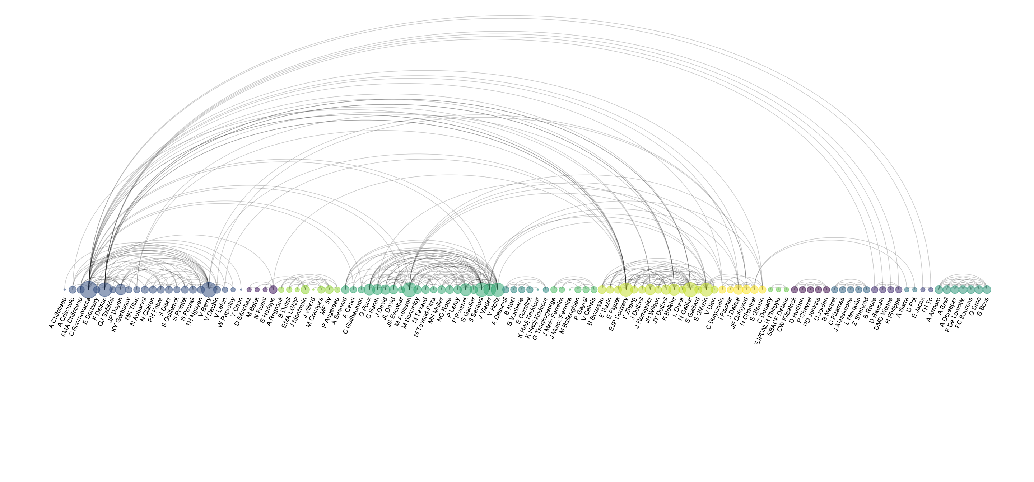
Co-authorship network of a researcher

Slide 42
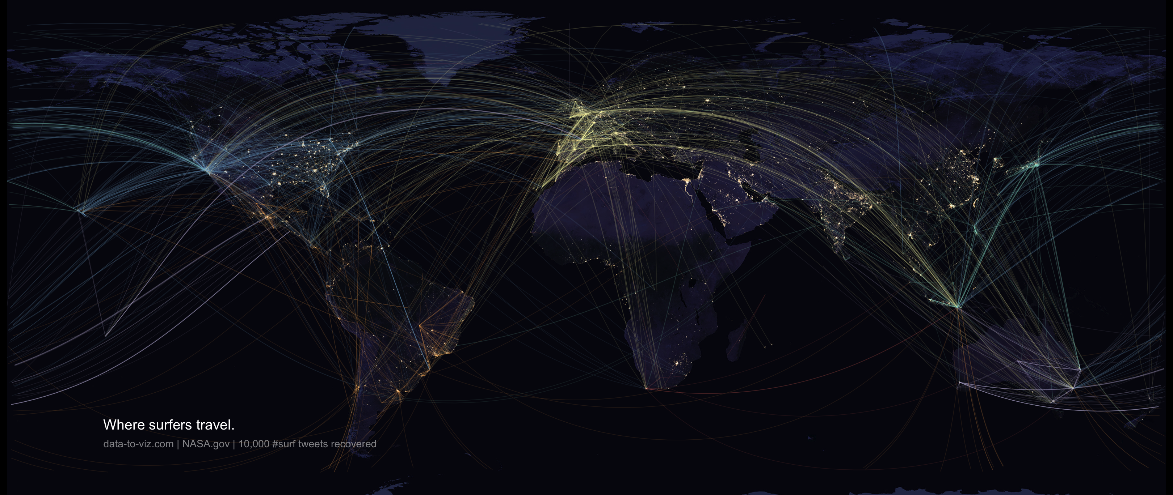

Slide 43
WHAT YOU SHOULD NOT DO
A gallery of most common caveats
www.data-to-viz.com/caveats

Slide 44
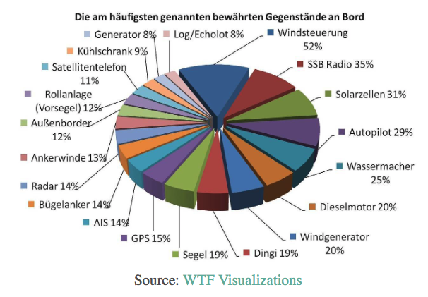
What’s wrong with this chart?

Slide 45
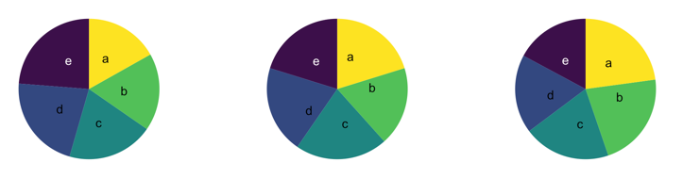
What’s wrong with pie chart?
What can you see?

Slide 46
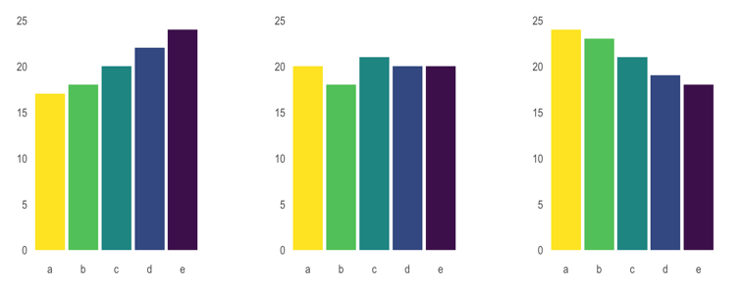
What’s wrong with pie chart?
It is hard to distinguish angles

Slide 47
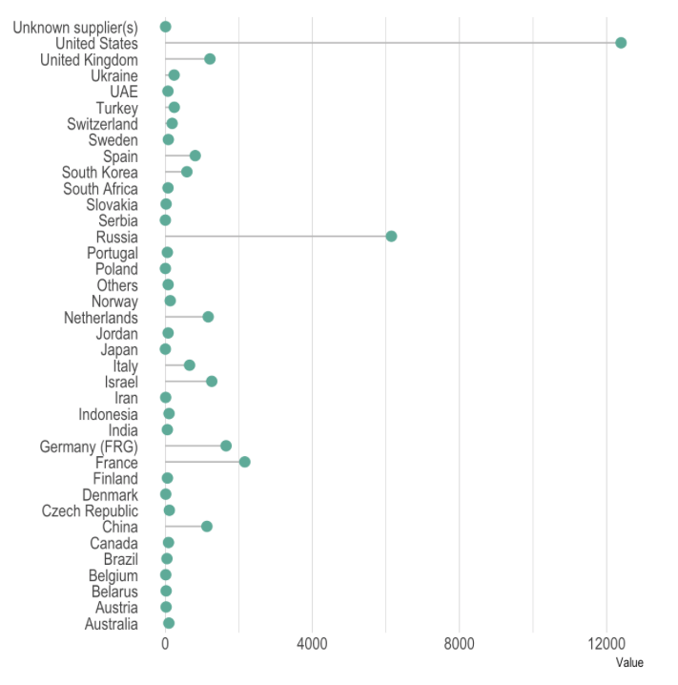
What could be better here?

Slide 48
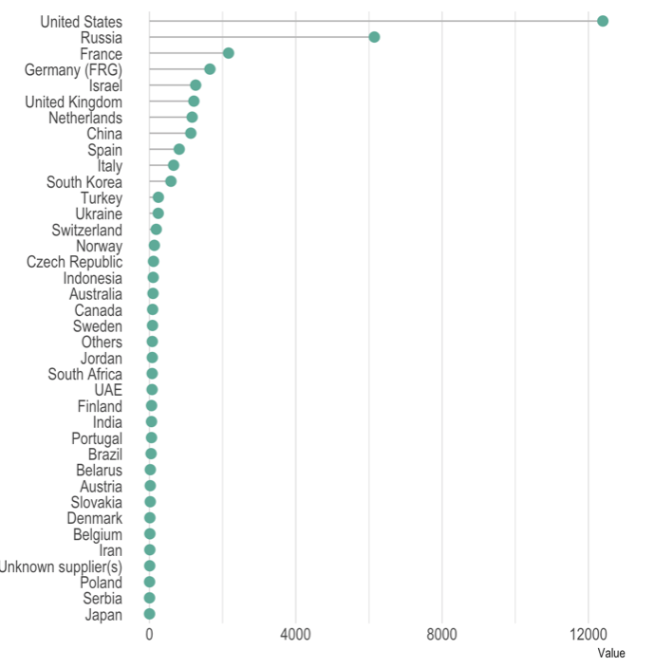
Order your data

Slide 49
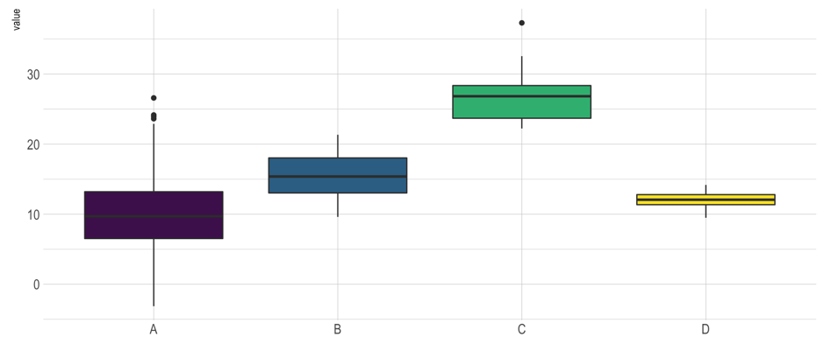
Anything wrong here?

Slide 50
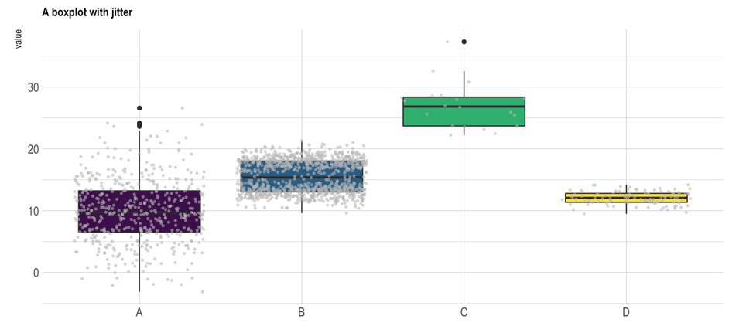
Boxplot = hide information
Almost no data !
Bimodal distribution

Slide 51
Boxplot = hide information
If small sample size, add data points with jitter
Almost no data !
Bimodal distribution

Slide 52
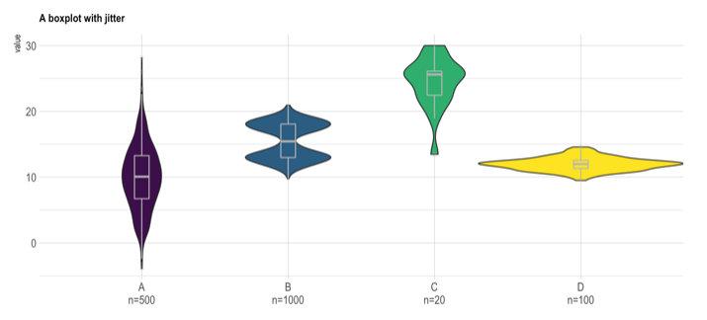
If big sample size, use violin plot
Show distribution
Show sample size

Slide 53
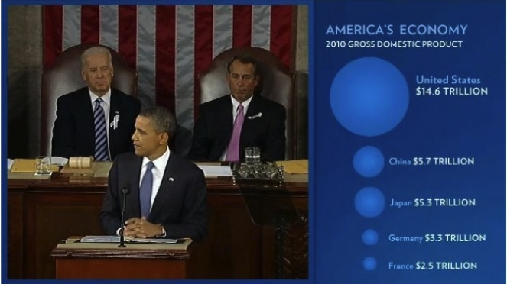

Slide 54
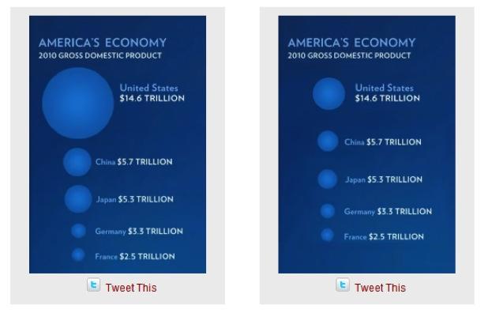
Size = radius
Size = area
Source: Fast Fedora blog

Slide 55
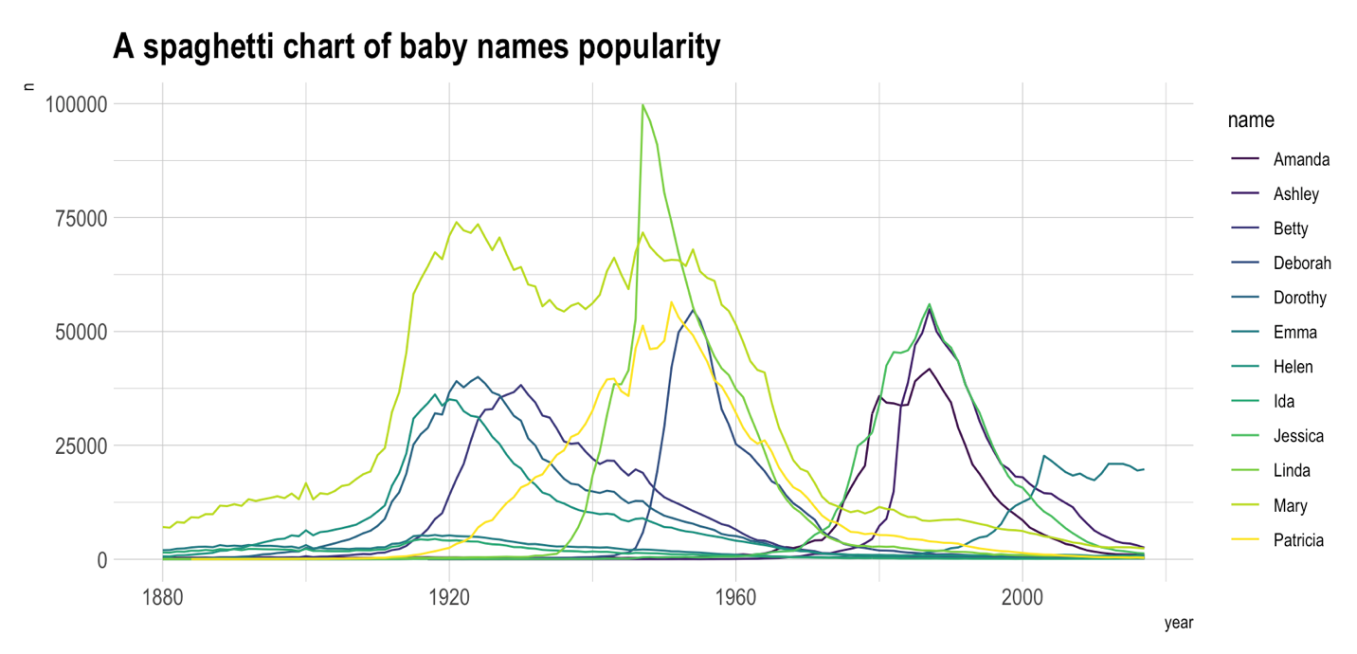

Slide 57
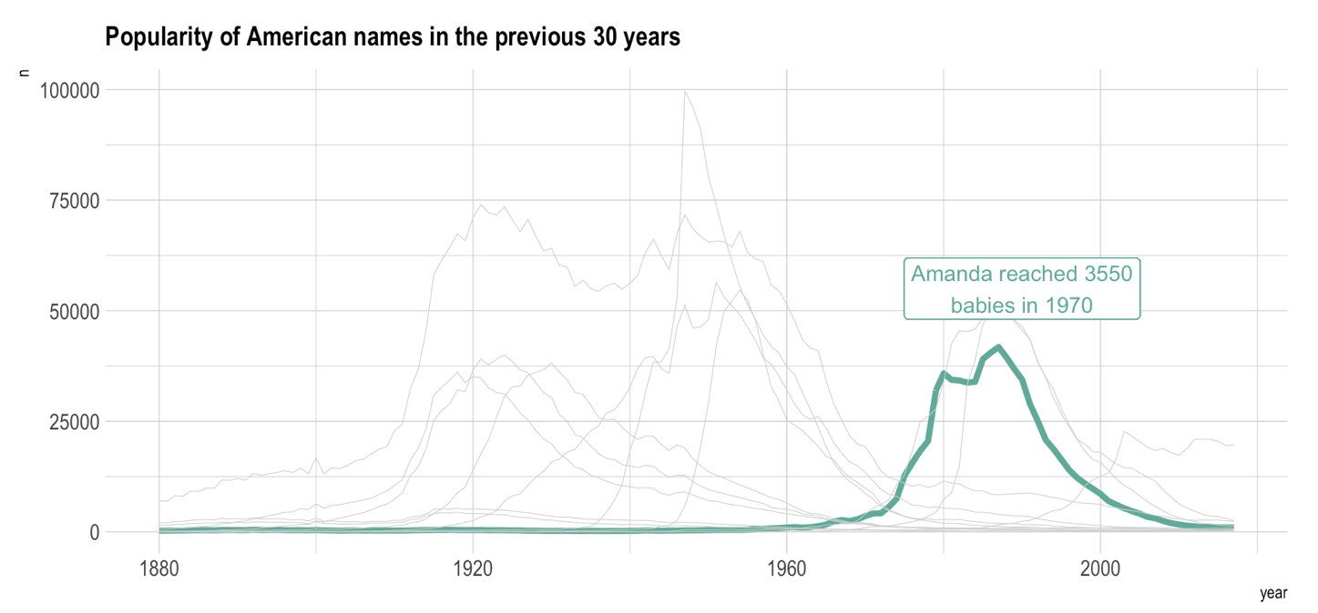

Slide 58
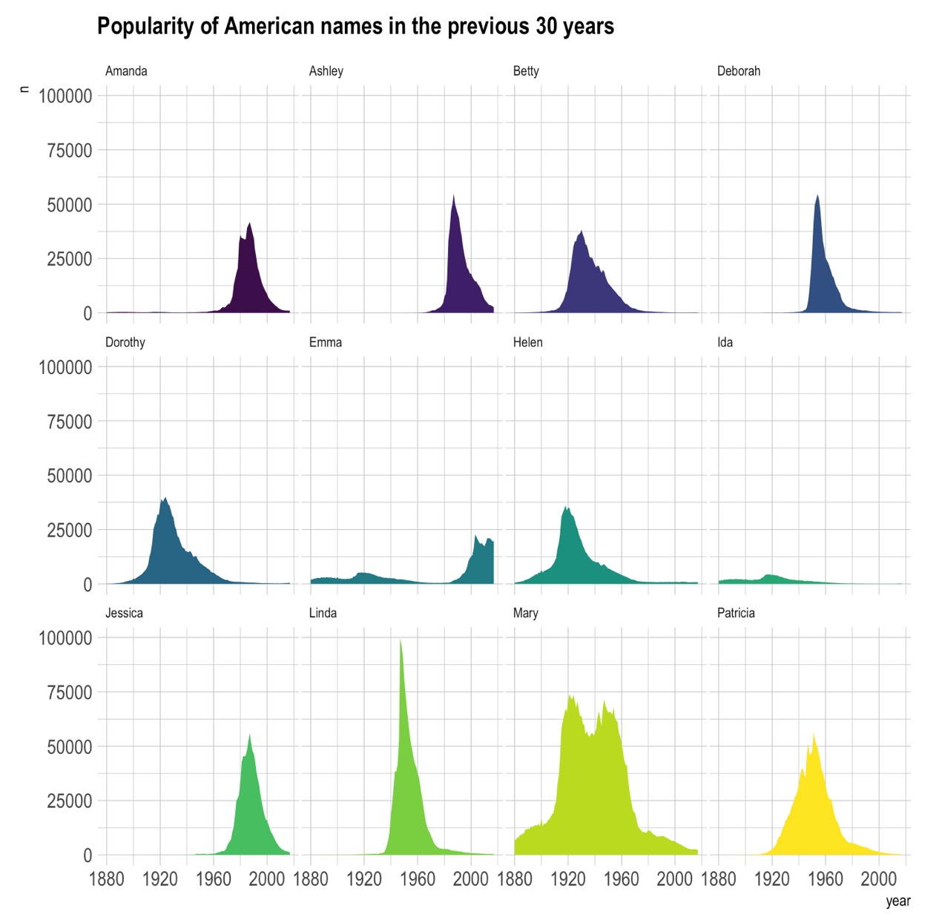

Slide 59
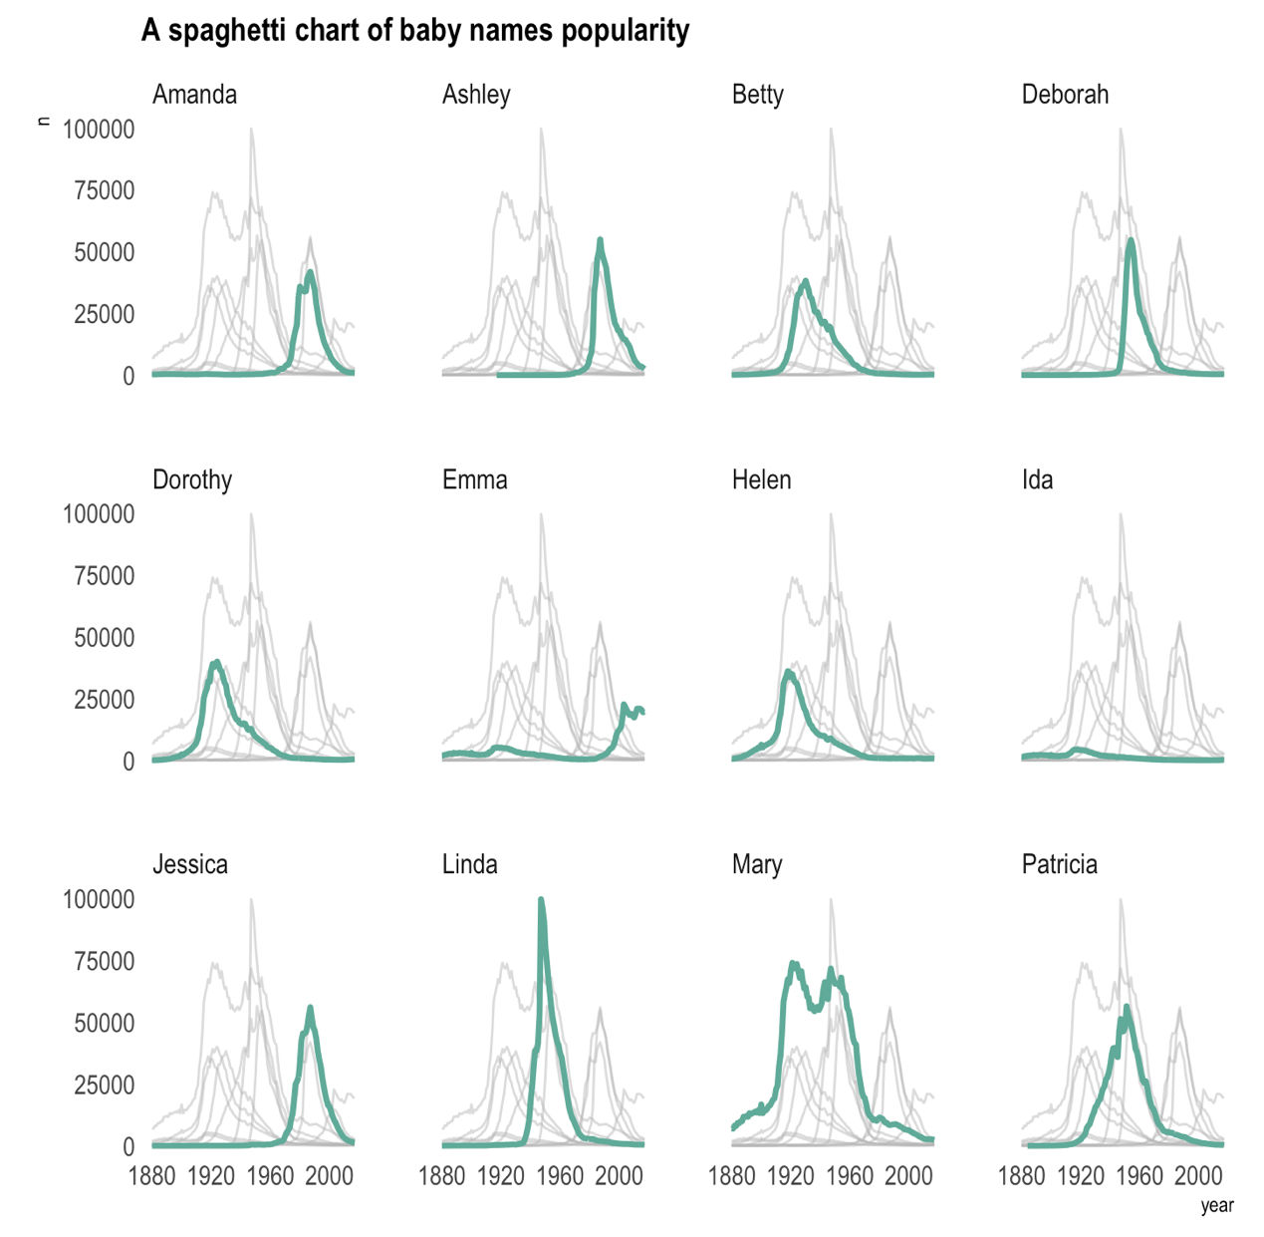

Slide 60
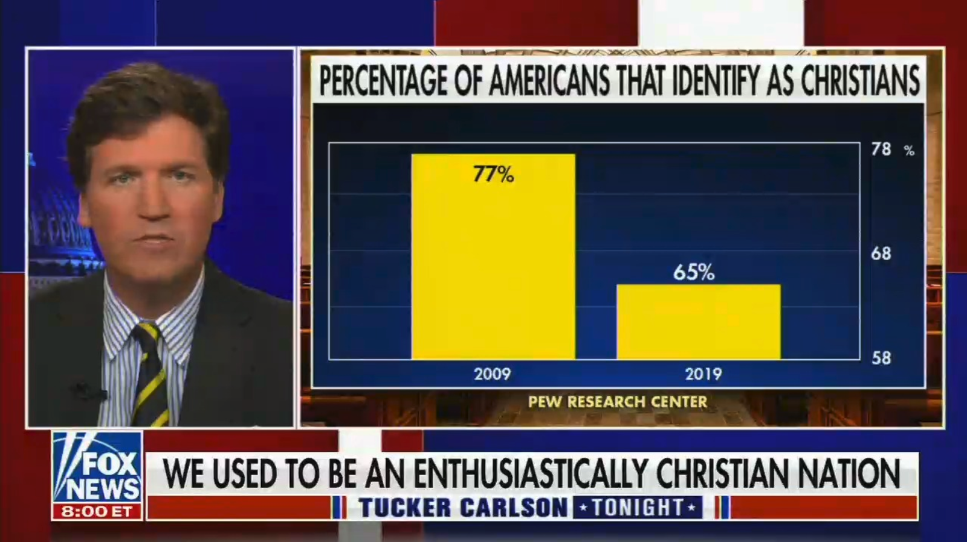

Slide 61
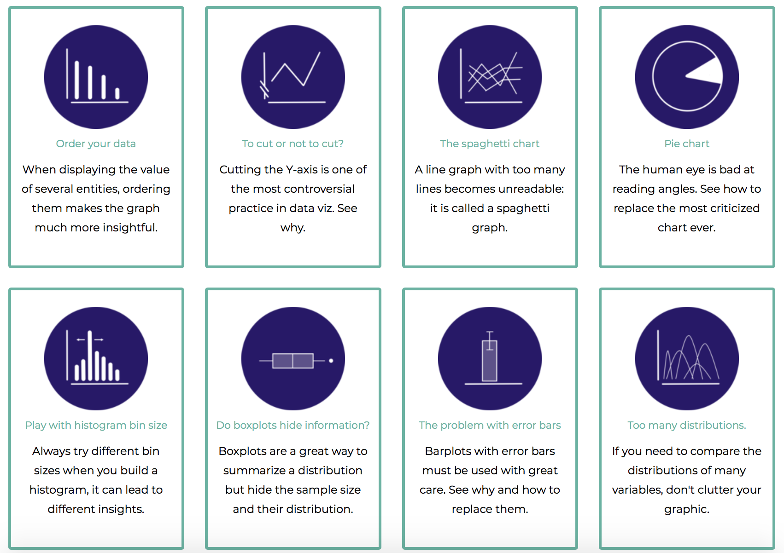
Data-to-viz.com/caveats
Data to Viz
A collection of dataviz caveats

Slide 62
HOW TO DO IT
The R and Python graph galleries

Slide 63
Design the idea
Build it
time
20 %
80 %

Slide 64

Easy
Limited
Hard
Flexible

Slide 65
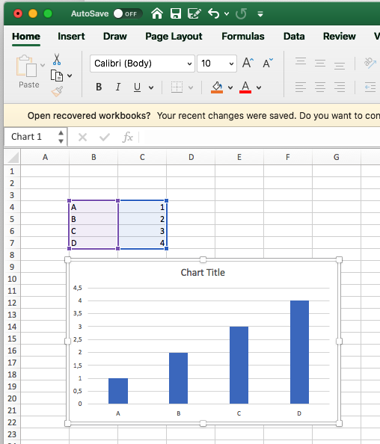
Excel
Easy
Limited
Hard
Flexible

Slide 66
Data Wrapper demo
Data Wrapper
Flourish
Tableau
Jump
Excel
QlikView
Easy
Limited
Hard
Flexible

Slide 67
R graph gallery demo
Data Wrapper
R
Flourish
Python
Tableau
SAS
Jump
MatLab
Excel
QlikView
Julia
Easy
Limited
Hard
Flexible

Slide 68
Data Wrapper
R
Flourish
Python
Tableau
SAS
Jump
MatLab
Javascript,d3.js and the web
Excel
QlikView
Julia
Easy
Limited
Hard
Flexible

Slide 69



Slide 70

R-graph-gallery.com
Python-graph-gallery.com
D3-graph-gallery.com
Notes:
Demo d3-graph gallery.com

Slide 71





Data-to-viz.com
@R_Graph_Gallery
github.com/holtzy/Talk
Yan.holtz.data@gmail.com
www.yan-holtz.com

Slide 72
Data wrapper demo
R Markdown demo
Ggplotly demo
D3.js demo
Some thoughts about animation
Any topic you would like to discuss?

